Slide 1

NAVIGATING THE DNS WHAT ROLE DOES IT PLAY IN
ECONOMIC GROWTH AND DIGITAL WASTE.
CORE SUSTAINABLE DEVELOPMENT GOALS
HANNAH FRANK
ICANN76 NEXTGEN Participant March 2023

Slide 2


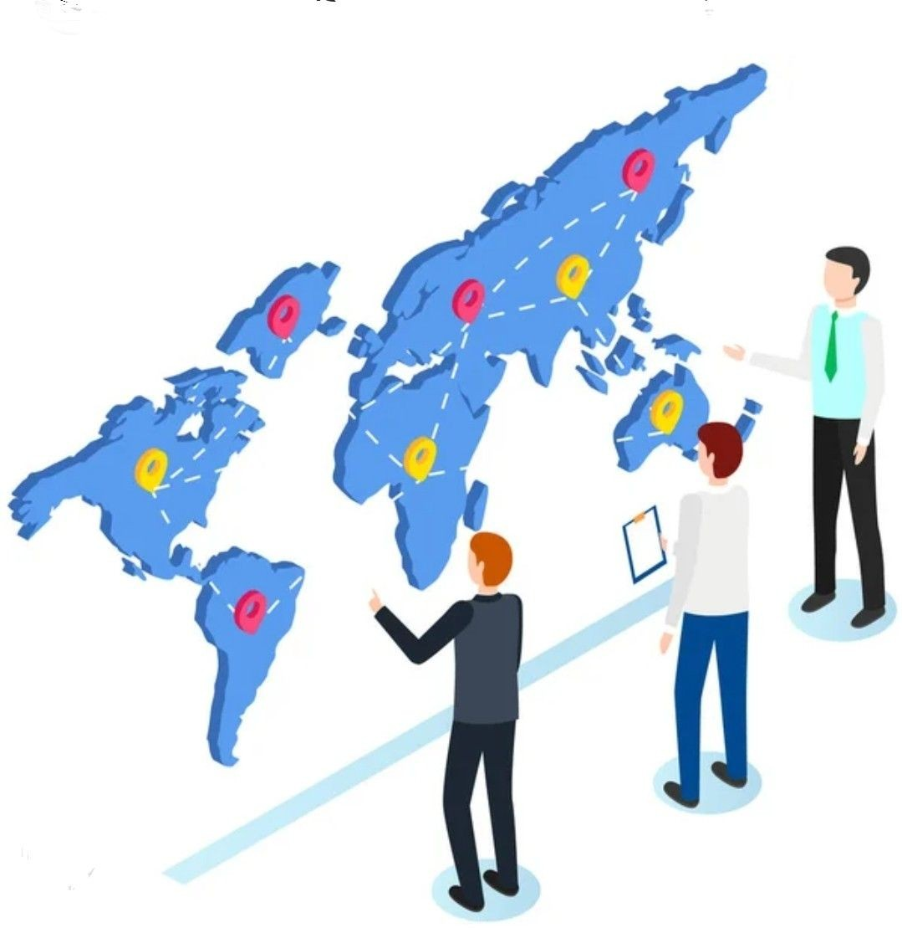
ONGOING DIGITAL TRANSFORMATION
NEW ECONOMIES
ENVIRONMENTAL BIOCENTRIC PARADIGM
Sustainable Development Goals

Slide 3
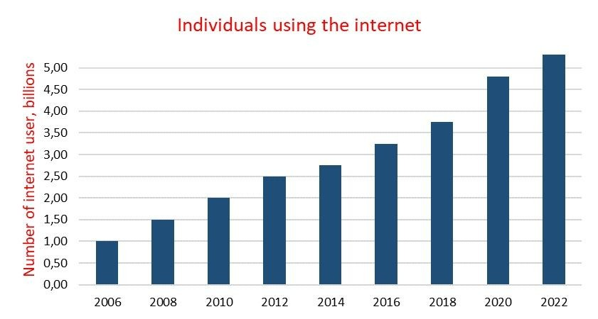
ONLINE ACCESS 2022
5.3 billion people 66% of total global population
Type something

Slide 4




DOMAIN NAME SYSTEM
1. FOUNDATIONS
OF INTERNET
2. ESSENTIAL LOGICAL INFRASTRUCTURE
3. KEY
COMPONENT
4.INTERNET HEAVILY RELIES
ON DNS
Source: OECD (2022), "Security of the Domain Name System (DNS): An introduction for policy makers", OECD Digital Economy Papers, No. 331, OECD Publishing, Paris, https://doi.org/10.1787/285d7875-en.

Slide 5



Slide 6

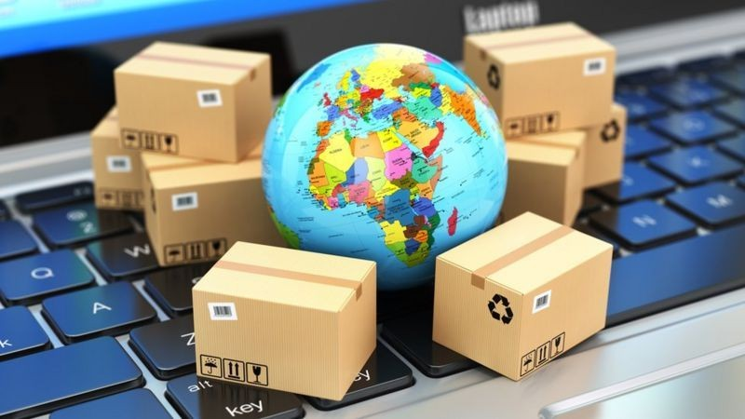

Forefront Digital economy
Online transactions
DNS
Profits- investments
Economic spur

Slide 7

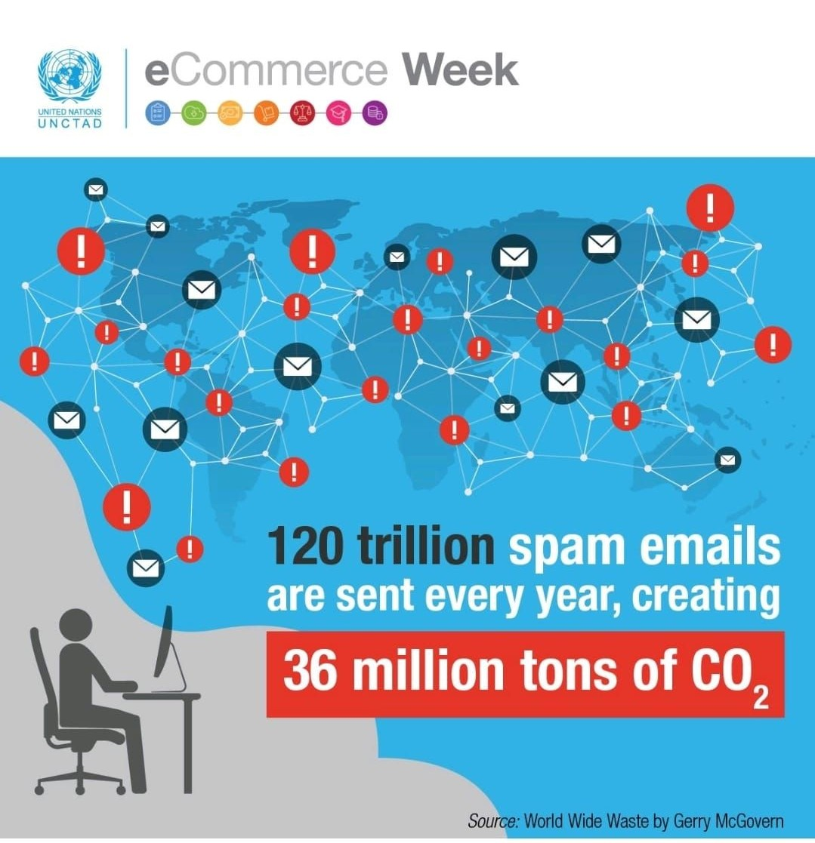
ROBUST DNS CONFIGURATION
EMAIL SPAM
DIGITAL WASTE MITIGATION

Slide 8
32 BILLION TREES WOULD NEED TO BE PLANTED EVERY YEAR TO OFFSET POLLUTION CAUSED BY EMAIL SPAM

Slide 9

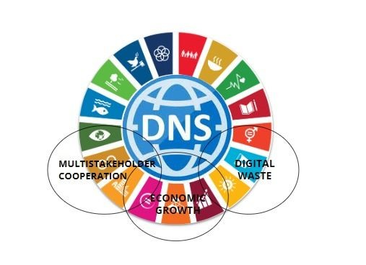
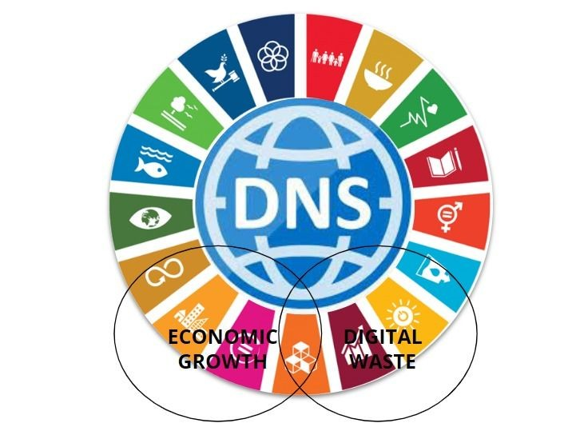

Slide 10



THAT'S A WRAP !
THANK YOU
HANNAH FRANK
ICANN76 NEXTGEN Participant
hannah.ffrank@gmail.com
https://www.linkedin.com/in/hannah-frank
March 2023

